Slide 1
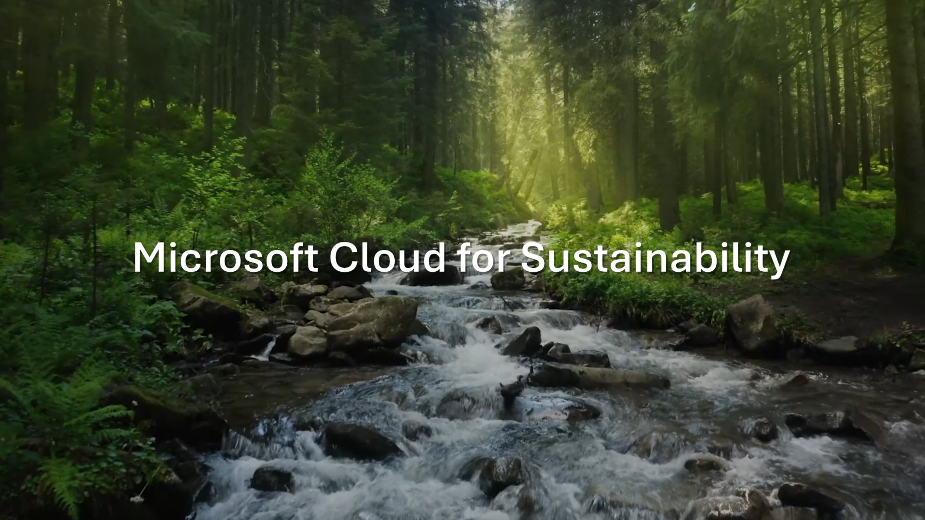
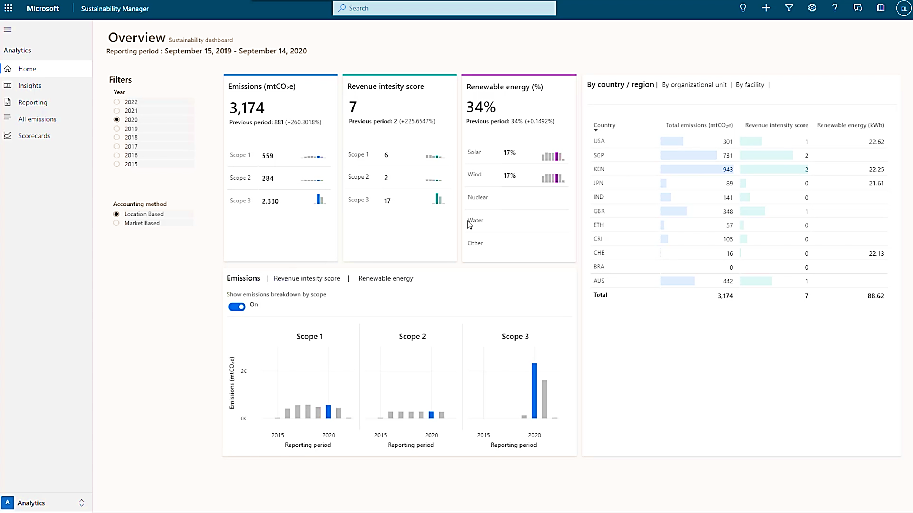
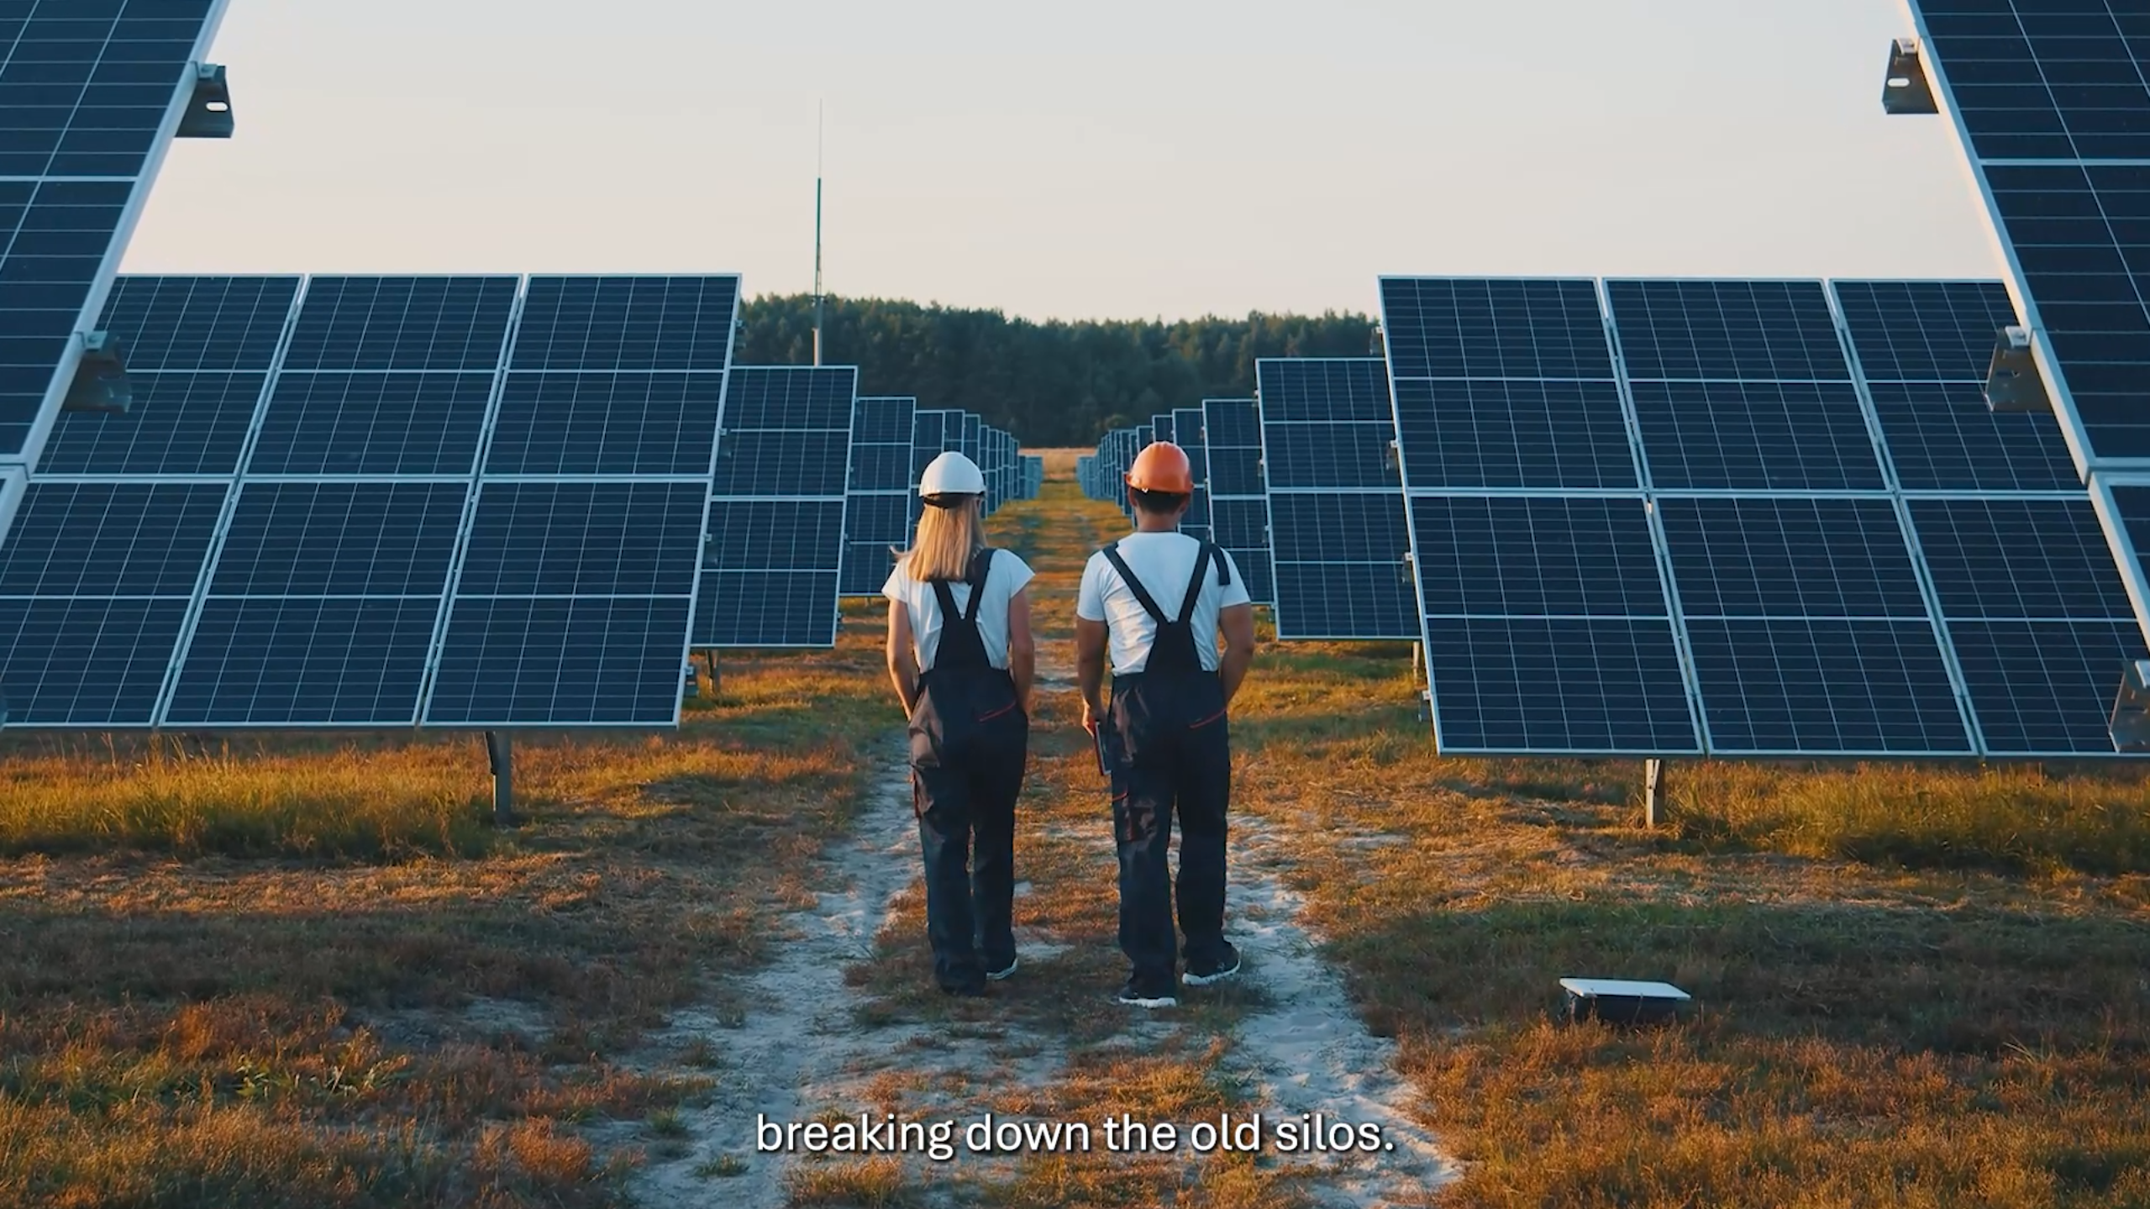
Microsoft Cloud for Sustainability
The Microsoft Cloud for Sustainability recently rebranded and updated its brand pillars to align with new cloud-based approaches. As part of this change, they were seeking a vendor to enhance their existing videos, help record new demos, and provide recommendations and best practices to help achieve their video goals.
Our Work
Worked closely with the client to understand video goals, grasp the content, offer guidance, and formulate video production timelines for two videos
Provided guidance on scripts based on new pillars and goals
Understood Microsoft Cloud for Sustainability personas to reflect them in the video accurately
Recorded demos and finalized custom graphics, music, and text animations
Generated closed-captioning meeting Microsoft’s Accessibility Conformance standards
The Result
The updated videos and demos now live on Microsoft’s Industry Content Hub highlighting the new initiatives for Microsoft Cloud for Sustainability

Slide 2
Product Videos highlighting Sustainability
A leading technology company recently rebranded and updated its brand pillars to align with new cloud-based approaches. As part of this change, they were seeking a vendor to enhance their existing videos and provide recommendations and best practices to help achieve their video goals.
Our Work
Worked closely with the client to understand video goals, grasp the content, offer guidance, and formulate video production timelines for two videos
Provided guidance on scripts based on new pillars and goals
Understood client's brand personas to reflect them in the video accurately
Created and finalized custom graphics, music, and text animations
Generated closed-captioning meeting client's accessibility standards
The Result
The videos now live on an internal hub highlighting the client's new initiatives for sustainability

